Slide 1
The feeling of code-mixing
Kie Zuraw, UCLA Dept. of Linguistics
Rethinking Bilingualism: Applied Approaches
UCLA, May 2024

Slide 2
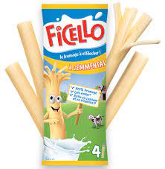
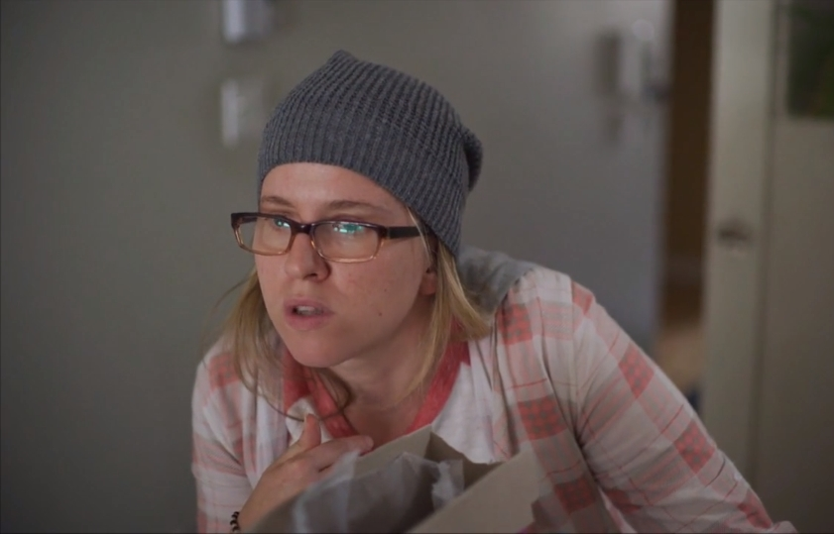
@#%!
Ça me prend mon Ficello
I need my string cheese
“M’entends-tu?”, episode “STOP STOP STOP”, Karine, played by Pascale Renaud-Hébert

Slide 3
@#%!
Ça me prend mon Ficello
I need my string cheese
pour me starter ma journée !
to start my day
start-er
[stɑɹt-e]
start-infinitive
start = commencer

Slide 4
starter ≠ commencer starter ≠ start
starter connotes…
Starting with a special infusion of energy needed to start
starting in the right way
Somewhat similar to…
English start off, start up, get started
French démarrer

Slide 5
Some examples found on French-language (Canadian) internet forums
Going to a party to starter your weekend
« Viens te starter le weekend avec nous! »
Starter a fantasy hockey league, with an emphasis on the effort required
« mettons, je veux me starter ma ligue pi je me sert de ton beta, quand tu va le fermer je vais tout perdre ? »
An obstetrician will give medication to starter (induce) labor
« mais a cause du diabete ma doc va (dépendamment de mon col) me starter le 9 au soir pour que jaccouche le 10 février »
Variety of meanings
→ even if starter is partly conventionalized, individuals are still deciding what meanings to give it
Notes:
The thing is though, starter doesn’t mean commencer, and it doesn’t mean start.

Slide 6
starter ≠ start, commencer
« À la dose que je le prends ca me fait comme un café ben fort, ca m'aide à me starter ma journée pis ca aide pour mon mood aussi. »
‘At the dose I take, it affects me like a good strong coffee; it helps me start off my day and it helps my mood too.’
www.reddit.com/r/montreal/comments/mqqnr6/une_plante_nomm%C3%A9e_kratom_fait_une_premi%C3%A8re/

Slide 7
starter ≠ start, commencer
« D'ailleurs je pense bientôt me starter mon propre one man show de jokes de vieux joueurs de hockey »
‘Besides, I’m thinking about starting up my own one-man show soon of jokes about old hockey players’
pucktavie.blogspot.com/2011/06/separes-la-naissance.html

Slide 8
starter ≠ start, commencer
« mettons, je veux me starter ma ligue pi je me sert de ton beta, quand tu va le fermer je vais tout perdre ? »
‘Say I want to start up my [virtual hockey] league and I use your beta, when you close it I’ll lose everything?’
www.hockeyvirtuel.ca/threads/simulated-hockey-manager-plateforme-web-de-gestion-du-logiciel-ehm.2669/

Slide 9
starter ≠ start, commencer
« mais a cause du diabete ma doc va (dépendamment de mon col) me starter le 9 au soir pour que jaccouche le 10 février »
‘but because of diabetes my doctor will (depending on my cervix) induce me the evening of the 9th so I give birth on February 10th’
www.mamanpourlavie.com/forum/post/milady087/page/108

Slide 10
starter ≠ start, commencer
« Viens te starter le weekend avec nous! »
‘Come start off your weekend with us!’
www.facebook.com/emmadejavu.sunshine/&usg=AOvVaw2xD-pVp-llal1JakjVvgpJ&opi=89978449

Slide 11
starter ≠ start, commencer
« Chaque personne est différente, si toi ça te prend une heure te starter le matin, ça veut pas dire que tout le monde est comme ça. »
‘Each person is different; if it takes you an hour to get started in the morning, it doesn’t mean everyone is like that.’
www.reddit.com/r/Quebec/comments/qplhn8/fonctionnaires_qu%C3%A9b%C3%A9cois_retour_au_bureau_%C3%A0/

Slide 12
starter ≠ start starter ≠ commencer
When bilinguals use a word from a different language, sometimes they’re using their resources to convey extra meaning
How does this work?
How did starter get this extra meaning?
➔ Proposal I: Because of their feeling of surprisingness, switched words can carry extra meaning

Slide 13
Predictable vs. unpredictable words
If you have any problems, just give me a ___
Easy to predict
Auto-complete on your computer or phone will probably suggest the right word
If he has any problems, just give him a ___
Hard to predict
Even if you know the context
Auto-complete will probably not suggest anything
call
nap? snack? user manual? reminder?

Slide 14
An illuminating experiment
Myslín & Levy 2015 took a corpus of conversations among Czech-English bilinguals and compared sentences like
A potřebuje entertainment ‘And she needs entertainment’
Ona se na tebe bude lepit ‘She will cling to you’
Czech has a word for entertainment, so why use the English word here?
They hypothesized that a switch is more likely when a word is unpredictable, unexpected
The switch alerts the listener to pay more attention
Caveat: There are many, many reasons for a switch to happen!
They wanted to know if there was still an effect of unpredictability on top of all the other reasons

Slide 15
How to measure unpredictability?
Participant has to guess what word the beeeep obscures, and type it
A potřebuje beeeep
Unpredictability = % of participants who couldn’t get the word in 6 guesses (translation equivalent counts as correct)

Slide 16

Myslín & Levy’s result
After controlling for many other factors, the words that speakers in the original conversations had chosen to switch into English were more unpredictable (harder to guess)
Their interpretation:
Consciously or not, the speaker is using the language switch to signal the listener to pay more attention
This will help the listener prepare for the unexpected word
www.alldogsunleashed.com/wp-content/uploads/2019/09/shutterstock_1122150491.jpg

Slide 17
But wait, how can a listener prepare to pay more attention, if the word has already started?
Early in the word, the English vowel and consonant sounds will sound different from Czech
A potřebuje entertainment ‘And she needs entertainment’
But the listener can also get some clues even before the word begins
Piccinini & Garellek (2014), Olson (2016): the rhythm and melody of the sentence (“intonation”) changes leading up to the switch
Partly this is inevitable, because the two languages have different intonation systems
But it can also serve to alert the listener that a switch is coming up
By the way, we do this kind of signaling in single-language sentences too:
We’ll have to do a lot of {like/you know/shall we say/pause} contortions
All these hesitations warn the listener that an unexpected word is coming up

Slide 18
Aside: does code-switching always work this way?
Myslín & Levy point out: using a language switch to signal upredictability works only if code-switching is itself at least slightly surprising
In a community where it’s typical for a sentence to contain multiple switches, this might not work
A Spanish/English example from New York City (reported by Poplack 1988):
“But I used to eat the bofe, the brain. And then they stopped selling it because tenían, este, le encontraron que tenía worms. I used to make some bofe! Después yo hacía uno d’esos concoctions: the garlic con cebolla, y hacía un mojo, y yo dejaba que se curare eso for a couple of hours.”

Slide 19
Back to starter
Now, what happens if a switch signals you that the word is unexpected, but it’s actually a rather plain, predictable word like start?
“…pour me starter ma journée”
Then the listener has to read between the lines.
We do this all the time!
My boss was on time today
→ reading between the lines, the speaker’s boss must often be late (otherwise, why would they have said this? This is Gricean Implicature, for the linguistics students here)

Slide 20
Back to starter
Another example of reading between the lines
Unlike in the “contortions” example, “interesting” is not a surprising or infrequent word here:
It was…interesting
It was, well, interesting
It was (high pitch at end of was) interesting
Reading between the lines, “it” was actually terrible, or shocking, or something else more than just “interesting”
When a person says something in an atypical way, the person they’re talking to infers that there must be an atypical meaning involved (Rett 2020, Levinson 2024)

Slide 21
Back to starter
How this applies to “…pour me starter ma journée”
By switching to English, the speaker tells us that start carries a lot of information
Reading between the lines, we guess they must mean not just start but something more
Context and general knowledge (e.g, about why people eat breakfast) help us guess that they mean start in the right way, requiring an infusion of energy
Notes:
So that’s one way that the feeling of code-switching (surprisingness, where applicable) can be a resource for conveying meaning
signal to the listener to pay more attention because extra info is coming up
Sometimes, force listener to read between the lines to guess what that extra info is

Slide 22
Besides the feeling of surprisingness, a switched word can also carry a feeling of separation from the word before, with some interesting linguistic consequences

Slide 23
Word structure
Starter: well integrated into French word structure, getting the “infinitive” suffix –er
starté – past participle
startais– imperfect
starterai – 1st singular future
startera – 3rd singular future
starteront – 3rd plural future
etc.

Slide 24
Word structure
But this doesn’t always happen
In France, verbs from another language often resist getting any suffixes
Si tu veux me follow sur Instagram… ‘If you want to follow me on Instagram”
In Canadian French (and for many in France too), this would be follower (infinitive)
Similarly for some loans from Romani (poucave, pénave), Arabic (khalass, nehess) and Occitan (marida)
→ Proposal II: Switched words can have special word structure (“morphology”), as a way to set them apart from the rest of the sentence

Slide 25
Intentionally funny Reddit post (by a Canadian)
Il est de plus en plus fréquent d'entendre des aberrations comme "T'as-tu spot la fille là bas?!" dans les rues du Québec. La règle est pourtant simple: en franglais québécois, tous les verbes anglais se conjuguent comme des verbes français du premier groupe. L'usage correct est donc "T'as-tu spotté la fille là bas?!"
It’s more and more frequent to hear aberrations like “T'as-tu spot la fille là bas?! » [Didja spot the girl there] in the streets of Quebec. The rule is simple, though: in Québécois Franglais, all the English verbs are conjugated like French first-conjugation verbs. The correct usage is therefore "T'as-tu spotté la fille là bas?!"
Continues in the style of a language-purist newspaper editorial
www.reddit.com/r/Quebec/comments/11epgm3/rappel_la_conjugaison_du_franglais_qu%C3%A9b%C3%A9cois/
I don’t know about the original poster, but certainly some of the commenters are genuinely annoyed by this development, perceived as influence from France (my translations):
When a hear a tech tell me he’s « reboot » the processer I lose it… it’s rebooté, you’ve REBOOTÉ the processer
I know you were just trashposting, but it annoys me non-ironically
[This] unleashes an emotional reaction. I don’t care about « daron » or « wesh » [slang words from France]. But make your verbs agree, like a civilized person, dammit!
This kind of sentence makes the hair on my arms stand up

Slide 26
French verbs that don’t take any suffixes
The thing is, in France, it’s not such a new development, and it’s not just for loanwords.
Shortenings: préco ‘to pre-order’(from précommander)
Initialisms: RT ‘to retweet’
And a kind of slang called verlan that re-orders sounds from the original word: ouèj ‘to play’ (from jouer), golri ‘to laugh, be amused’ (from rigoler)
By the way verlan nouns can also opt out of the French plural system by adding a suffix, but I’ll leave that for another day…
Not putting verb suffixes on these “special” words serves to set them apart from the rest of the sentence
Is this for the listener’s/reader’s benefit?
E.g., telling them to pay more attention?
Or a product of the speaker’s/writer’s feeling that the word is special?
I won’t offer an answer, but..

Slide 27
Code-switched words, loans, abbreviations, initialisms, verlan and other slang
All feel a bit separate from the rest of the sentence
In English too, suffixes on these kinds of words may be avoided or set off with special punctuation
Several chaebol were implicated in the scandal
All the department admin’s were there
They OK’d the deal

Slide 28
Code-switched words, loans, abbreviations, initialisms, verlan and other slang
All are likely to be written with “quotation marks” or italics, or spoken with an air quotes gesture
Quotation marks and italics call attention to a word’s form instead of just its (usual) meaning
Distance the speaker/writer from the material
Delegitimizing: His “contributions” to the meeting were mostly just complaints
Direct quotation: She said she was “devastated” by the news
Talk about a word
Consider the difference between “cat” and “kitty”
Onomatopoeia
The shoes made a “slip-slop” sound
Signal unexpectedness/newness
“Harmonic grammars” use constraint weighting instead of strict ranking
Add emphasis or enthusiasm, though this is stigmatized for quotation marks (not stigmatized for italics)
“Fresh” tomatoes!
If you know Japanese, notice the overlap with uses of katakana

Slide 29
By the way, when are loans italicized and when not?
I’ll show you a restaurant review from the New Yorker magazine
it’s one of the few English-language periodicals left that has the resources to do serious fact-checking and copy-editing
So I’m assuming that these choices are not random but rather reflect some kind of in-house style manual

Slide 30
“A bowl of ayacote beans, firm-fleshed with satiny insides […] Duck enmoladas are pure, melting intensity: long-braised dark-meat carnitas in a black-garlic mole, wrapped in a chewy tortilla made from amaranth. It’s blanketed by an opaque white layer of what the menu calls “cotija foam,” which is actually more like an airy sauce mornay, salty and rich. The menu is laced with obscure regional ingredients such as chintixtle, a Oaxacan paste made from dried chilis and dried shrimp, or chicatanas, crisp flying ants that taste like salt and smoke. This makes Caballero’s more obvious moves feel, well, obvious: a blue-corn quesadilla made with asadero cheese somewhat gratuitously pairs huitlacoche—a naturally occurring corn fungus sometimes called “Mexican truffles”—with shaved actual truffle. Cutting through all the big, rich flavors was a zingy dish of shrimp aguachile. […] with sultry, herby notes of shiso and Japanese cherry blossoms.”
Some of the food words are italicized, indicating that they’re not English
But others aren’t—I guess the New Yorker editors consider these words as English now?
www.newyorker.com/culture/the-food-scene/mexican-ish-fine-dining-with-detours-corima

Slide 31
“A bowl of ayacote beans, firm-fleshed with satiny insides […] Duck enmoladas are pure, melting intensity: long-braised dark-meat carnitas in a black-garlic mole, wrapped in a chewy tortilla made from amaranth. It’s blanketed by an opaque white layer of what the menu calls “cotija foam,” which is actually more like an airy sauce mornay, salty and rich. The menu is laced with obscure regional ingredients such as chintixtle, a Oaxacan paste made from dried chilis and dried shrimp, or chicatanas, crisp flying ants that taste like salt and smoke. This makes Caballero’s more obvious moves feel, well, obvious: a blue-corn quesadilla made with asadero cheese somewhat gratuitously pairs huitlacoche—a naturally occurring corn fungus sometimes called “Mexican truffles”—with shaved actual truffle. Cutting through all the big, rich flavors was a zingy dish of shrimp aguachile. […] with sultry, herby notes of shiso and Japanese cherry blossoms.”
Some of the food words are italicized, indicating that they’re not ordinary English
But others aren’t—I guess the New Yorker editors consider these words as ordinary English now?
I imagine the writer and the copy-editor debating this, since a word’s ordinariness depends on each writer or reader’s experiences

Slide 32
How about pronunciation?
We’ve now seen that avoiding the usual verb suffixes, etc., helps “special” words, including code-switched words, retain their distinctness
Which may help them have their desired rhetorical effect
Code-switched words can also be set apart in their pronunciation
We’ve already touched on intonation: the rhythm and melody of a sentence can change in the lead-up to a switch
But there’s more…

Slide 33

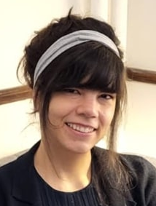
Katsuda, Repiso-Puigdelliura & Zuraw
an experiment we’ve presented at a couple of conferences but not published yet
He’s got great asparagus
Because the t is between two vowels, the sound structure of English says that it can optionally get pronounced as a “tap” sound, similar to Spanish r.
d words the same way: good asparagus
He’s got great abejas
Can the English rule still apply to this t, even though one of the vowels that’s necessary to fulfill the conditions of the rule is from a Spanish word?
Hiro Katsuda Gemma Repiso-Puigdelliura

Slide 34
Participant reads out loud and is audio-recorded
Participants were UCLA students who are bilingual in Spanish and English.
As it turned out, all grew up in the U.S., raised by parent(s) from Mexico and/or Central America
He’s got great abejas

Slide 35
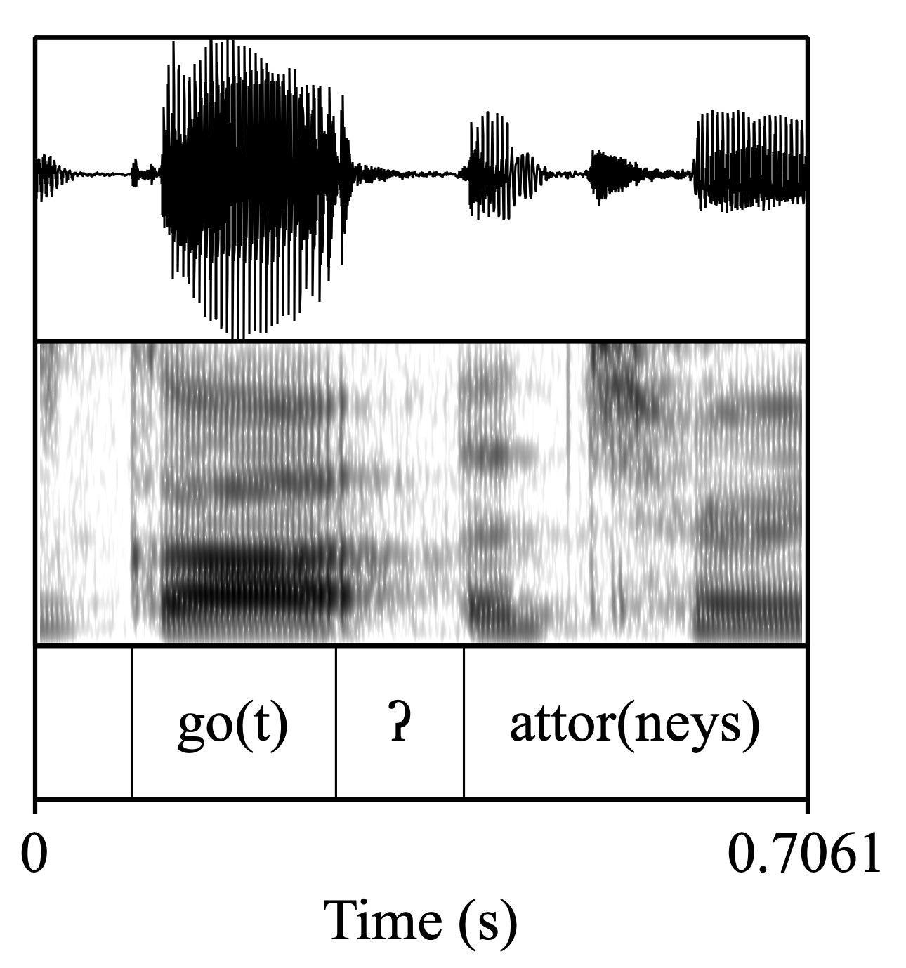
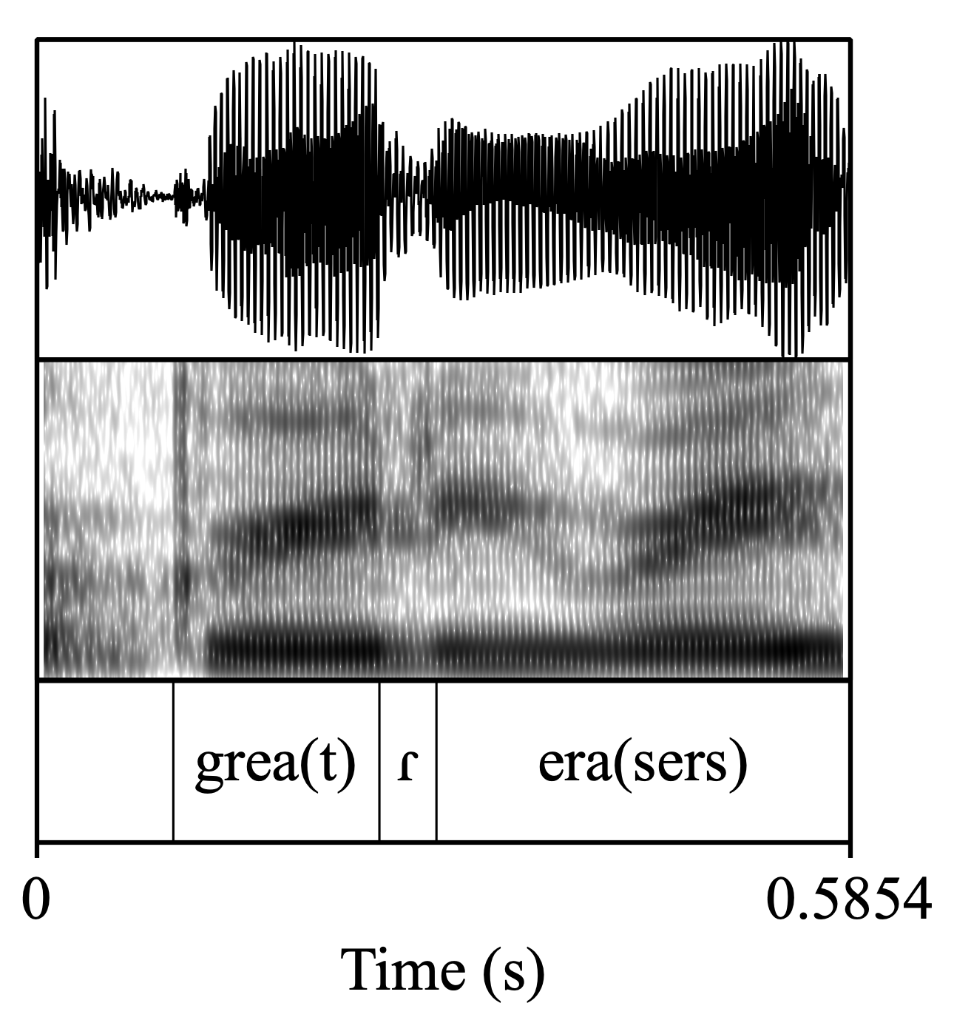
Acoustic analysis

Slide 36
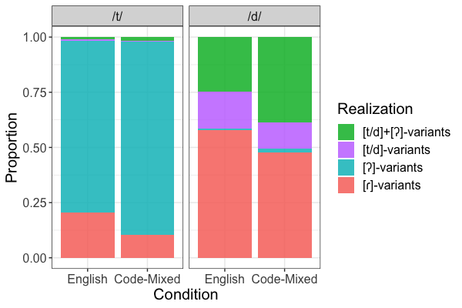
Results
The rule can apply, to both t and d, in all-English sentences and in code-mixed sentences
But, it applies more often in the all-English sentences

Slide 37
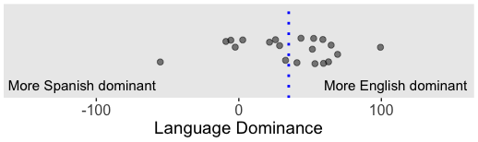
But wait…
Let’s look more closely
It’s very rare for a bilingual to have exactly the same proficiency in both languages
We used a questionnaire about language history, use, and proficiency, to give each participant a number ranging from very Spanish-dominant to balanced (0) to very English-dominant:
If we split the participants into two equal-sized groups, we can compare the more balanced half to the more English-dominant half…

Slide 38
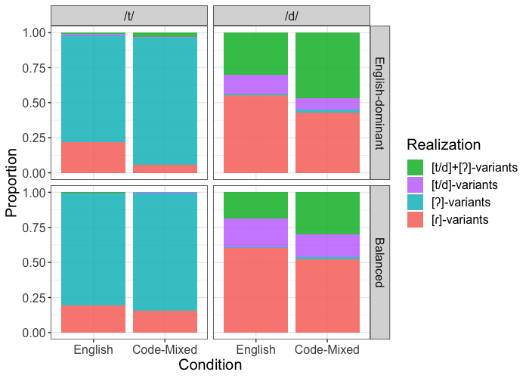
But wait
The difference between all-English sentences and Code-Mixed sentences is driven by English-dominant bilinguals:
They’re saying go[ʔ] abejas a lot more than go[ɾ] abejas
This makes sense in terms of speech planning

Slide 39
Speech planning
In order to pronounce it go[ɾ] abejas…
when you’re planning (unconsciously) how to pronounce the t of got
you need to already know that the next word will start with a vowel
If you haven’t planned that far in advance…
You can pronounce it as t (rare) or a [ʔ] (“glottal stop”)
Previous research on all-English sentences finds that people are less likely to produce the “tap” sound [ɾ] when the second word is infrequent or unpredictable
rabbit ears vs. rabbit evenings
(Kilbourn-Ceron & al. 2020, Kilbourn-Ceron & Goldrick 2021)
Infrequent and unpredictable words take longer to retrieve from the mental dictionary

Slide 40
Speech planning
What could this have to do with language dominance?
For people who use English for more of their day and week…
Spanish words are effectively lower frequency
Lower-frequency words take longer to access from the mental dictionary
So, more English-dominant participants could be less likely to get abejas cued up fast enough to plan a tap in got

Slide 41
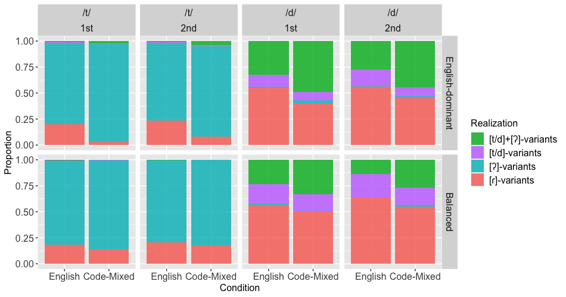
Further support for the delayed-access theory
Participants read all the sentences through once (“1st” block), took a short break, then read them all again (“2nd” block)
The effect is the very strongest in Block 1, when the sentences are all brand-new to the participants

Slide 42
Proposal III: Switching languages can produce a discontinuity in speech planning, which can cause the pronunciation of a word to also be set apart
Especially, avoid processes that merge the switched word with a previous word
like English tapping or French liaison/elision

Slide 43
Current experiment, if you’re curious
Four sound rules instead of just one
both English and Spanish rules
rules that change both the word before the switch and the word after the switch
Longer sentences that change in the middle instead of at the end
Administering not just the Bilingual Language Profile (Birdsong & al. 2012) but also…
Bilingual Code-Switching Profile (Olson 2024)
MINT sprint (Gollan 2024: 3-minute vocabulary test, for both English and Spanish)

Slide 44
French vowel-initial words
French really doesn’t like a syllable to begin with a vowel sound, and sometimes there are ways to avoid it
The simplest way is to delete a vowel
‘the boy’ is le garçon
3 syllables, all start with consonants: le – gar – çon
‘the child’ is not *le enfant, but l’enfant
2 syllables, both start with consonants: l’en – fant
Same goes for words spelled with h, which is silent in French
Not *le héritage, but l’hé – ri – tage ‘the heritage’
(There are also cases where a consonant gets inserted, or a different form of a word is used.)

Slide 45
French vowel-initial words
But there’s a set of exceptions where this doesn’t happen
le hérisson ‘the hedgehog’
le houblon ‘the hops’
You mostly have to memorize these
But there are types of words that you can guess will likely be exceptions
Proper names: Hugo, Octave (varies)
Verlan words: ouf (from fou)
Initialisms: H.L.M. (varies)
Mentioning a word or part of a word: le oui “the ‘yes’”
And…loanwords!: ukulélé (varies)
Authors have long noted that making one of these words an exception, and thus having it start its own syllable, helps to “conserve its individuality” (Malmberg 1943)
This set of words should look familiar—it overlaps a lot with the “special words” that tend to get put in quotes or italics, tend to avoid suffixation in French

Slide 46
Language switch → break in pronunciation
For both English tapping and French vowel-initial words, there are a number of possible mechanisms
Slight delay in accessing word
it’s not ready in time to be planned with the preceding word
Can’t apply rules like the English tap rule, or French rules that move a consonant from the end of one word into the same syllable as the beginning of the next word
Default speech posture
= the “speech-ready” posture that your lips, tongue, etc. adopt before/between actually speaking
varies from language to language
The most proficient bilinguals have distinct default postures for each language (Wilson & Gick 2013)
Switching from one posture to the other might be hard to do without a clean syllable boundary
Deliberate signal to the listener
“pay extra attention to this unexpected word”
Or just keeping the unexpected word more distinct so it’s easier to perceive

Slide 47
Emotional charge
I’ve talked up till now about how and why certain words are special, but their specialness hasn’t carried much emotional charge.
I’m personally very interested in—but won’t have time to talk about today—cases where code-switched words carry a strong emotional charge
Childhood words
In multilingual families, endearments, scoldings, and general childhood words may remain associated with the heritage language, even for generations that have mostly switched to the majority language
These words can carry strong emotional charge for both the speaker and the hearer
For obvious social and cultural reasons
But maybe also because early-learned words seem to have different brain representation
Possibly more diffuse
Possibly more linked to sensory information (see Brysbaert & Ellis 2016 for a review)

Slide 48
Emotional charge
Swearing
There’s lots of research on how swearing feels (to the swearer and the swear-ee) and why
Distinctive sounds (Lev-Ari & McKay 2023)
Distinctive neurolinguistics (Stephens 2018 review)
Experience of inhibiting and disinhibiting these words
Especially in bilinguals (e.g., Sulpizio & al. 2019)
A recurrent finding—which I bet will match your own experience—is that swear words in a second language feel less strong

Slide 49
How does code-mixing make you feel?
How does code-mixing make you feel?
Meaning, what feelings does it give you?
How does code-mixing make you feel?
What are the mechanisms by which it makes you feel something?
How do these feelings and mechanisms affect code-switched words’ linguistic properties?
Switch signals unexpectedness → can force listener to impute extra meaning → switched words can gain additional meaning
Switch can feel distinct from what came before it in the sentence → special word structure
Switch can disrupt speech planning → avoid applying certain sound rules
Something to think about: how do you and other bilinguals exploit all this to enrich your communication?

